Slide 1

PERFORM intermediate meeting
Bristol, April 10th -12th
(Month 18)

Slide 2
Today
Morning
Feedback of the technical and financial report (UOC)
WPs planned activities for the 2nd half of the project (WP leaders)
Group discussions on WP2 participatory workshops (TBVT) and WP5-WP6 final conference (UNESCO & EUSEA)
Afternoon
Group discussions (same than before)
Tomorrow
Morning
Self-evaluation tool for RRI & gender within PERFORM project
Group discussions on WP3 ECR recruitment and training (UoB), WP4 planning of social media and assessment instruments (UAB & UoW), WP6 planning of dissemination and communication (EUSEA)
Afternoon
School recruitment and other pending issues & scheduling M19 to M36 (UOC)
· PERFORM Consortium Meeting. Bristol, April 10-12th, 2017 ·

Slide 3
Wednesday
2nd General Assembly **1 representative from each partner organization**:
Participatory workshops in each case study
ECRs recruitment in each case study
Case studies’ coordination of each WP tasks
Final conference date
Reporting: structure, timing, edition
Next payment
Results’ dissemination and communication plan: definition of a PERFORM dissemination activity and responsibility to communicate it to the parties
4th Steering Committee **only WP leaders**:
WP1 AB evaluation process: selection of deliverables to send to each member, timing, guidelines for the evaluation
WP2-WP3-WP4 coordination of activities in each case study
WP5 – WP6 coordination for the final conference
WP1-WP6 coordination for dissemination actions
Preparation of the evaluation meeting with the P.O. and external reviewer on April 26th
· PERFORM Consortium Meeting. Bristol, April 10-12th, 2017 ·

Slide 4
Feedback of the technical and financial report
Many thanks for your accurate and timely contributions!
The intermid report was submitted on time
10 deliverables and 2 milestones were successfully achieved in this period (M1-M15)
· PERFORM Consortium Meeting. Bristol, April 10-12th, 2017 ·

Slide 5
Feedback of the technical and financial report
To improve for next reports (both internal and the final one to the EC)
Each partner is responsible for the work conducted and must include its own contribution to each WP and Task in the technical report, don’t expect WP leaders or the CT will do it for you!
Information included in the technical report must be formulated clearly enough to be understood by people not involved in the project, e.g., avoid the excessive use of acronyms.
Provide records on your participation in dissemination and communication activities for the participant portal.
Ensure the correspondence between your technical and financial reports.
· PERFORM Consortium Meeting. Bristol, April 10-12th, 2017 ·

Slide 6
Feedback of the technical and financial report
Financial expenses M1-M15 (executed vs. planned)
Partner | Executed (% of total budget)
 | Personnel costs | Subcontracting | Other direct costs | Overheads | Total
UOC | 52,036.24€ (38.25%) | - | 3,718.58€ (15.37%) | 13,938.71€ (34.80%) | 69,693.53€ (34.80%)
TBVT | 43,260€ (22.89%) | 2,841€ (28.41%) | 4,890.90€ (12.08%) | 12,037.73€ (20.98%) | 63,029.63€ (21.23%)
UoB | 50,178.98€ (26.07%) | - | 12,817.13€ (27.96%) | 15,749.03€ (26.43%) | 78,745.14€ (26.43%)
SMS | 24,971.70€ (34.59%) | - | 7,103.84€ (72.49%) | 8,018.89€ (39.12%) | 40,094.43€ (39.12%)
UoW | 49,650.67€ (32.46%) | 0€ (0.0%) | 4,696.29€ (16.44%) | 13,586.74€ (29.94%) | 67,933.70€ (26.97%)
AJA | 10,270.32€ (25.23%) | - | 2,820.27€ (76.22%) | 3,272.65€ (29.48%) | 16,363.24€ (29.48%)
TRACES | 65,524.76€ (68.25%) | - | 7,565.24€ (93.40%) | 18,272.50€ (70.21%) | 91,362.50€ (70.21%)
UNESCO | 42,938.57€ (39.04%) | - | 35,609.08€ (31.24%) | 19,636.91€ (35.07%) | 98,184.56€ (35.07%)
EUSEA | 18,105€ (14.37%) | - | 6,418.02€ (35.66%) | 6,130.76€ (17.03%) | 30,653.78€ (17.03%)
UAB | 55,614.03€ (44.97%) | - | 5,744.71€ (15.09%) | 15,339.69€ (37.93%) | 76,698.43€ (37.93%)
Total | 412,550.27€ (49.92%) | 2,841.00€ (8.84%) | 91,384.06€ (38.17%) | 125,983.58€ (47.28%) | 632,758.91€ (31.68%)
· PERFORM Consortium Meeting. Bristol, April 10-12th, 2017 ·

Slide 7
Feedback of the technical and financial report
Effort M1-M15 (executed vs. planned)
Partner | Executed (Planned whole project)
 | WP1 | WP2 | WP3 | WP4 | WP5 | WP6 | Total
UOC | 6.12 (12) | 1.08 (2) | 0.7 (2) | 6.27 (22) | 0.54 (2) | 0.6 (2) | 15.31 (42)
TBVT | 0.5 (1) | 10.2 (42) | 0.71 (4) | 0.69 (3) | 0.1 (2) | 0.16 (2) | 12.36 (54)
UoB | 0.2 (1) | 0.37 (7) | 8.76 (31) | 0 (0) | 0 (2) | 0 (2) | 9.33 (43)
SMS | 0.88 (1) | 10.27 (30) | 0.94 (2) | 0.3 (2) | 0.08 (1) | 0.68 (2) | 13.15 (38)
UoW | 0.55 (1) | 0.88 (2) | 1.19 (6) | 3.3 (14) | 0 (1) | 0.77 (2) | 6.69 (26)
AJA | 0.55 (1) | 0.17 (1) | 1.9 (6) | 0 (1) | 0 (0) | 0.05 (1) | 2.67 (10)
TRACES | 0.47 (1) | 14 (18) | 0.04 (0) | 0.39 (1) | 0 (2) | 0 (1) | 14.9 (24)
UNESCO | 0.4 (1) | 0 (0) | 0 (0) | 0 (0) | 12 (15) | 0.09 (6) | 12.49 (22)
EUSEA | 0.3 (1) | 0 (0) | 0 (0) | 0 (0) | 0 (2) | 2.72 (18) | 3.02 (21)
UAB | 3.15 (4) | 0.3 (2) | 0.76 (1) | 14.84 (33) | 0.1 (1) | 0.3 (2) | 19.45 (43)
Total | 13.12 (24) | 37.27 (104) | 15 (53) | 25.79 (76) | 12.82 (28) | 5.37 (38) | 109.37 (323)
· PERFORM Consortium Meeting. Bristol, April 10-12th, 2017 ·

Slide 8
Feedback of the technical and financial report
To consider for financial management in the next period
Budget is an estimation, minor deviations between actual and planned expenses are ok but explanations are needed.
H2020 allows for budget transfer from one beneficiary to another (between partners).
H2020 allows for budget transfer from one category to another (between personnel and other direct costs).
H2020 allows for budget transfer within personnel costs (between WPs).
An amendment is needed for subcontracting!
· PERFORM Consortium Meeting. Bristol, April 10-12th, 2017 ·

Slide 9
Feedback of the technical and financial report
To consider for next period: Actual and envisioned risks (Risk Management Plan)
Low participation of students in social media:
If students do not participate in Twitter, University of Warwick will conduct qualitative interviews for assessment purposes by using a video conference and telephone calls in order to minimize cost.
Lack of schools’ support to students and teachers participating in PERFORM:
Case study coordinators promote schools’ engagement through organising promotional meetings with schools in order to explain the benefits of the project. They also keep smooth communication with school principals to discuss any potential barrier and tackle it as soon as it is identified.
In Spain, schools’ participation is encouraged by providing them with educational material.
UNESCO offers official recognition for participating schools in the three countries.
· PERFORM Consortium Meeting. Bristol, April 10-12th, 2017 ·

Slide 10
Feedback of the technical and financial report
Low engagement of early career researchers in performance science education approaches and trainings:
Researchers involved in the project receive expenses payment for participating in workshops, if needed.
Initial meetings between PERFORM members and researchers are conducted to explain the project activities in which their involvement is required, being flexible enough to deal with their academic commitments.
In the UK, WP3 leader keeps good communication with involved researchers and their supervisors so that they are encouraged to participate and their participation is valued.
Low teachers’ engagement in performance science education approaches:
UNESCO offers official recognition for participating teachers in the three countries.
In France, teachers are motivated by their involvement in trainings and dissemination events organised by the project.
In Spain, participant teachers in the trainings have official recognition by the corresponding regional Department of Education.
In the UK, if needed, teachers are provided with an economic compensation by the case study coordinator to cover their time in the project.
· PERFORM Consortium Meeting. Bristol, April 10-12th, 2017 ·

Slide 11
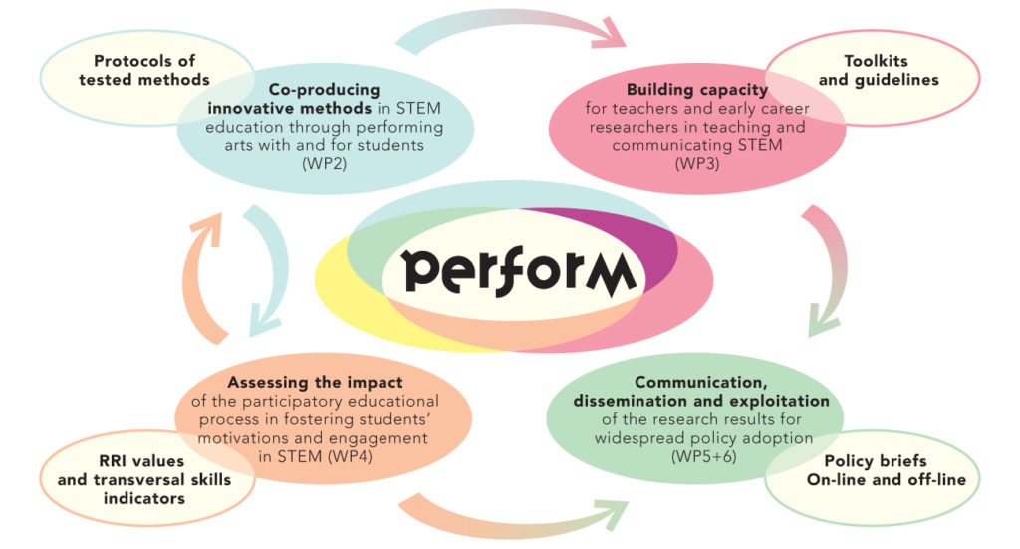
· PERFORM Consortium Meeting. Bristol, April 10-12th, 2017 ·

Slide 12
Feedback of the technical and financial report
To consider during this meeting
This is a collaborative project, we are not competitors!
Discussions must be constructive. Critics must be accompanied with proposals. Otherwise we’ll be stuck.
This is a research in which we are exploring methods and processes by trial and testing, final products will need time. But mediocrity must be avoided. We are expected to achieve a level of excellence.
We must act responsibly and keep a professional attitude when working with involved actors (students, teachers, ECR, schools …). Their participation is voluntary and they have no time to lose, take care of them!
Listen to each other, give the benefit of doubt, English is not the first language of all of us.
· PERFORM Consortium Meeting. Bristol, April 10-12th, 2017 ·

Slide 13
Presentations of WPs
WP leaders will present the planned activities.
Partners will ask for points to discuss in WP group discussion sessions.
· PERFORM Consortium Meeting. Bristol, April 10-12th, 2017 ·

