Slide 1
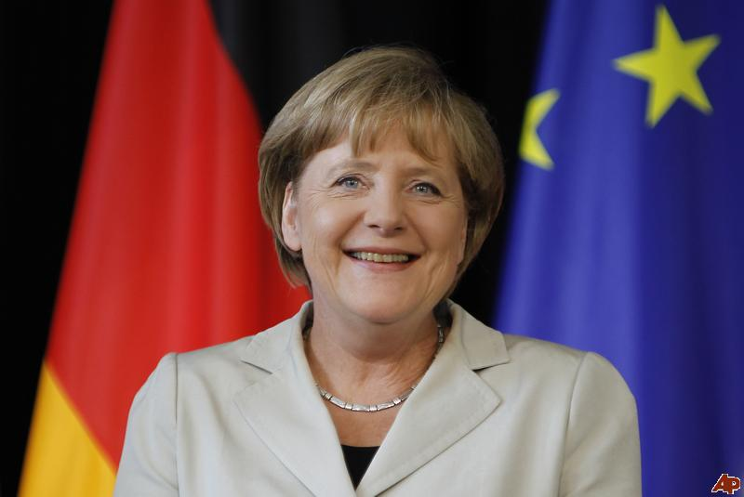
Notes:
Angela Merkel: Studied Physics at Leipzig University
Member of the academic staff at the Central Institute of Physical Chemistry at the Academy of Sciences
Awarded a doctorate

Slide 2
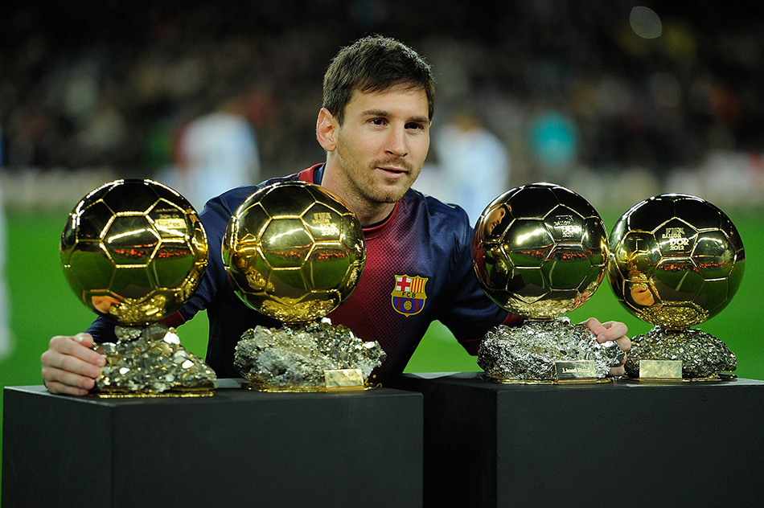
Notes:
Lionel Messi:
He abandon his studies in the last year of High School, at 16 years old.

Slide 3
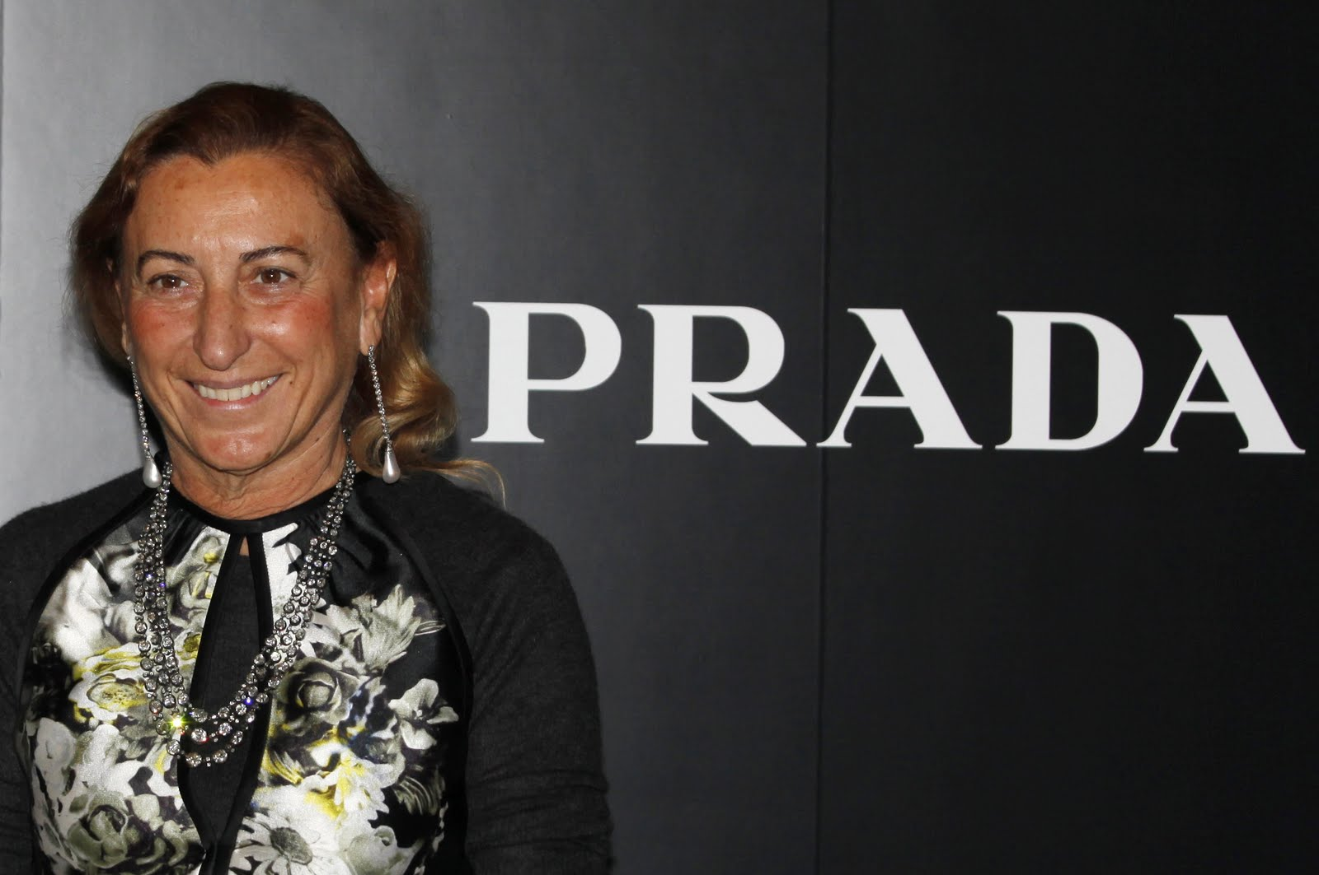
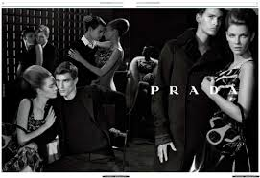
Miley Cirus
Notes:
Maria Bianchi Prada, professionally known as, Miuccia Prada.
She has a PhD in Political Science, which she followed with five years studying performing mime.
Miuccia Prada, has an estimated net worth of $4.2 billion as of May 2015 according to Forbes

Slide 4
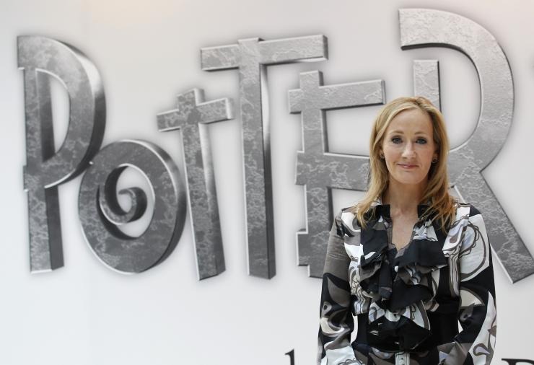
Notes:
Joanne Rowling
Rowling graduated from Wyedean and began attending Exeter University for her BA in French.

Slide 5
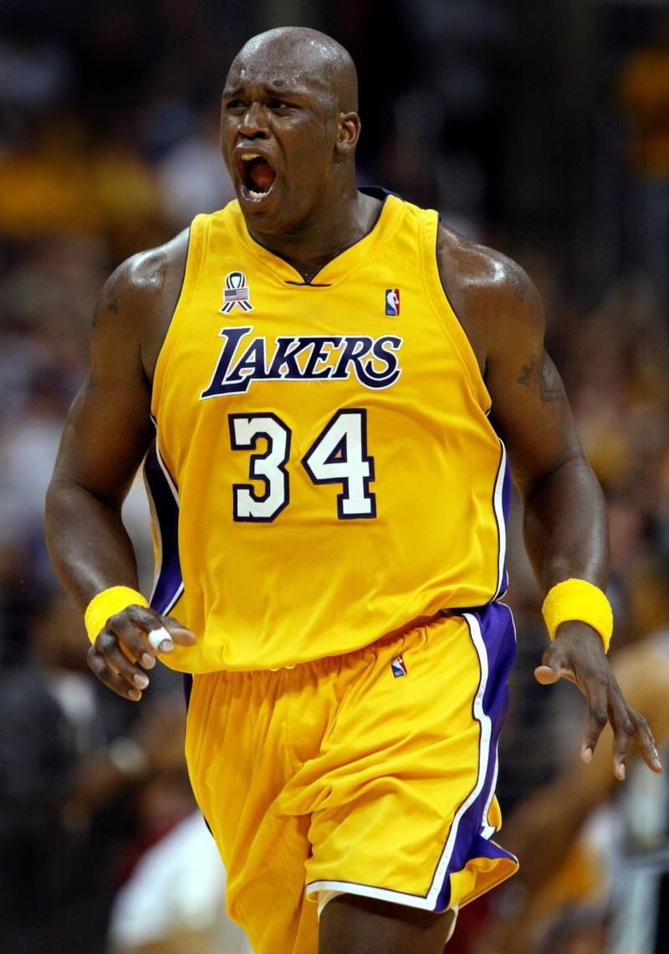
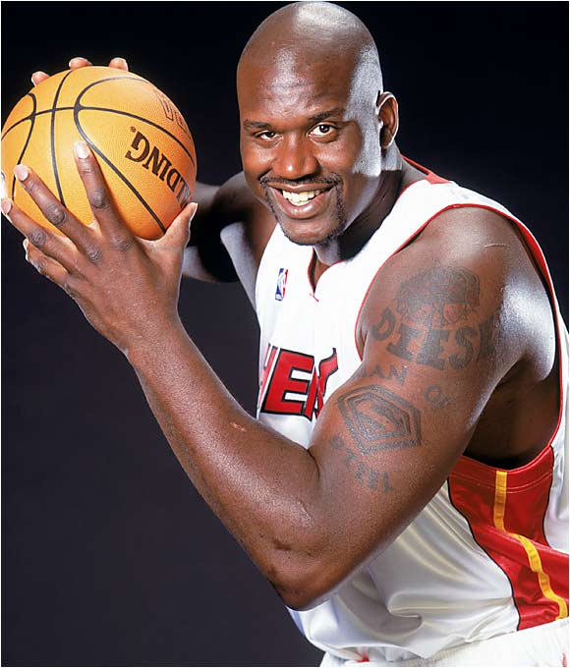
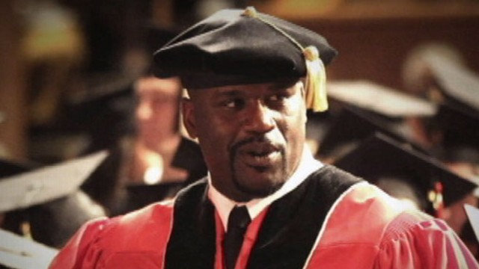
Notes:
Shaquille O’Neal
He earned his B.A. at Louisiana State University, MBA at University of Phoenix, and Ed.D. (doctorate) at Barry University.
His doctoral thesis focused on how CEO’s and business leaders employ humor within the workplace, and the effects of doing so. O’Neal praised his parents for their strong valuing of education, which they instilled in him from a young age – though he left university early to begin playing in the NBA, he returned to earn his first degree from Louisiana State University in 2000

Slide 6
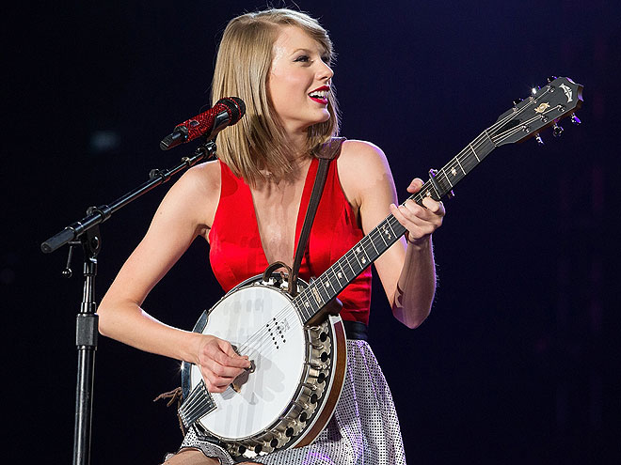
Notes:
Taylor Swift:
She was a junior in high school when she made her debut. She continued high school until there was scheduling conflict. She went on a home schooling program and got her diploma.

Slide 7



Notes:
Dr. Greg Graffin
Dr in Zoology

Slide 8
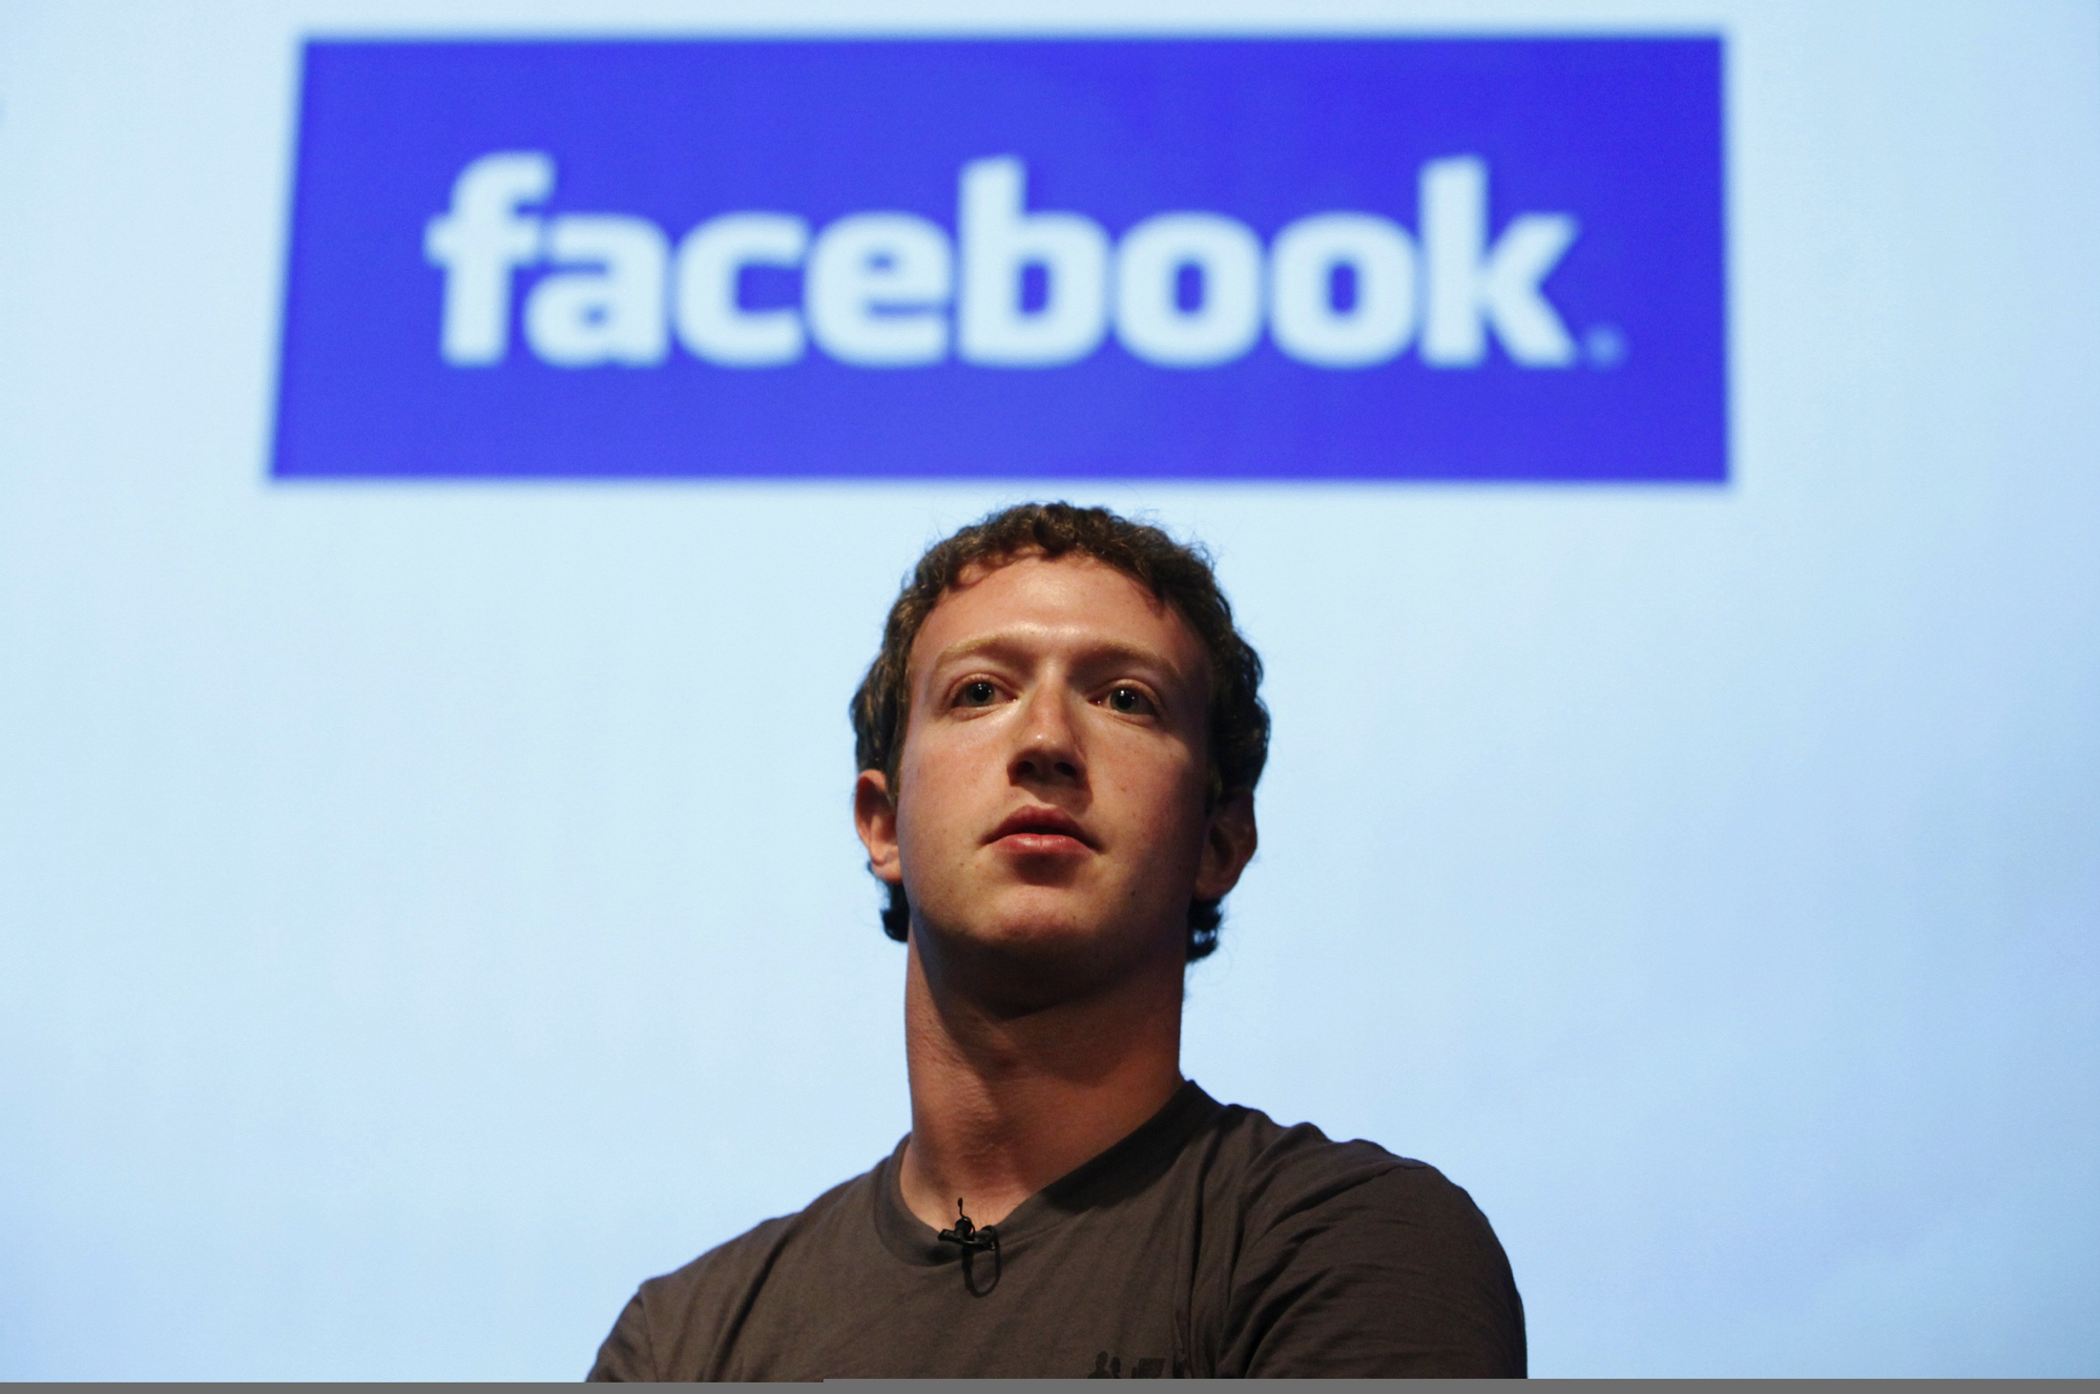
Notes:
Mark Zuckerberg
graduating from Phillips Exeter Academy, an exclusive preparatory school, in 2002
Zuckerberg enrolled at Harvard University,
After his sophomore year, Zuckerberg dropped out of college to devote himself to Facebook full time, moving the company to Palo Alto, California.

Slide 9
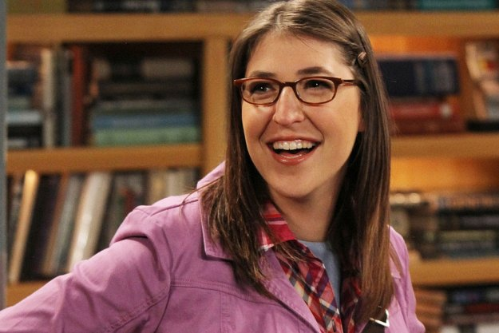
Notes:
Mayim Bialik
received her master’s degree in neuroscience

