Slide 1

Knowing at birth,
how you will die

Slide 2

Choose the sex of your child

Slide 3

Create a human being who will never have heart disease

Slide 4
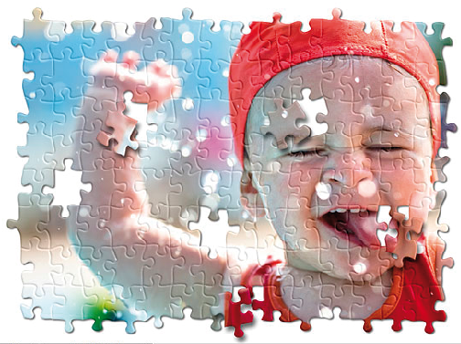
Create a living organism from inert matter

Slide 5
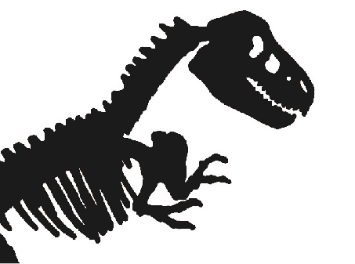
Recreating an
extinct species

Slide 6
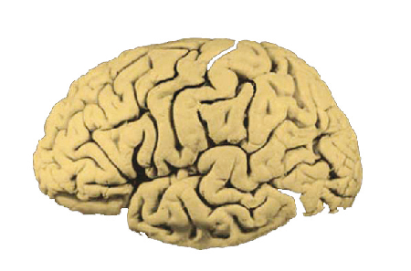
Create a child who will always
be top of the class

Slide 7

Creating a bacterium
that produce energy

Slide 8

Inserting the heart of a pig
into a human being

Slide 9
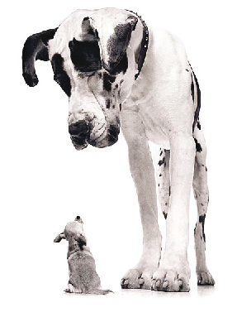
Creating a custom size dog

Slide 10

Cloning a human being

Slide 11

Bringing back to life someone who
has been under cryogenic process

Slide 12
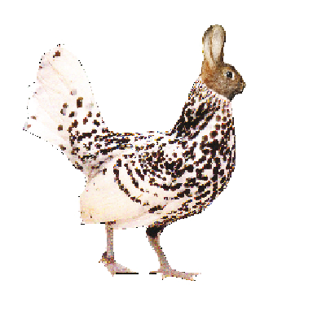
Merging a rabbit
with a chicken

